Slide 1
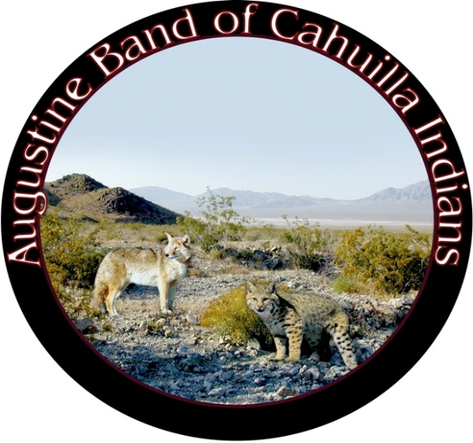
NEXT FIFTY YEARS: EFFECTS OF CLIMATE CHANGE THAT MAY IMPACT THE Augustine Band of Cahuilla Indians (ABCI)

Slide 2
OUTLINE OF THE PRESENTATION
ABCI and Other Tribal Nations – Unique Impacts of Climate Change
Climate Effects of Major Importance to ABCI – Next 50 years
Temperature Rise
Increased Fire Risks
Drought
Sea Level Increases and Indirect Impacts (such as Invasive Species)
Conclusions and Next Steps
Alliances and Data Sharing Networks
Working Group of Stakeholders to assess risks and assets to be protected

Slide 3
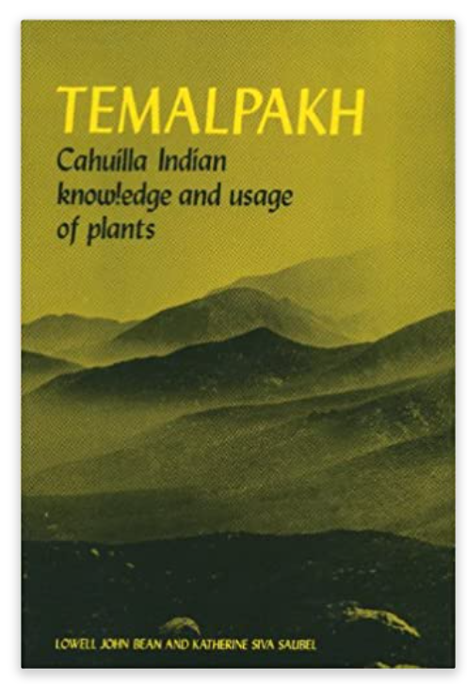
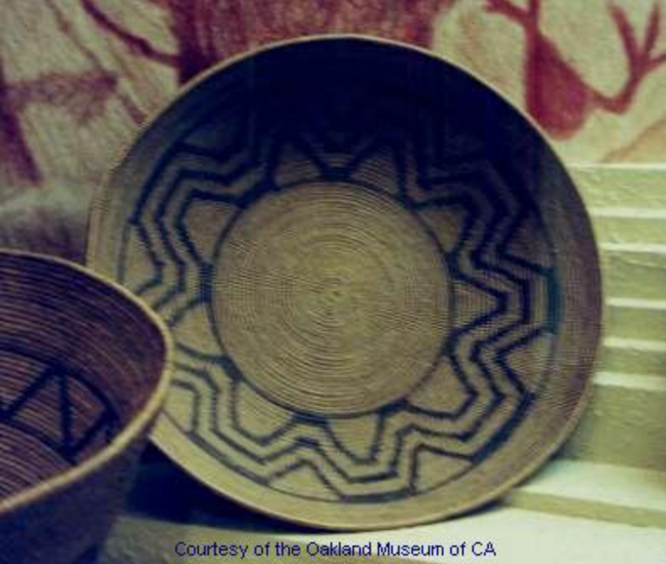
ABCI and Other Tribal Nations – Unique Impacts
Climate change is causing the loss of traditionally important plants, exacerbated by invasive species of plants and insects
Traditional plants that were used by the Cahuilla for food and ceremonies include the agave (the hearts were roasted underground), yucca, mesquite beans often used as a flour, seeds of many kinds, wild fruits, acorns – the book Temalpakh: Cahuilla Indian Knowledge and Usage of Plants, by Lowell John Bean and Katherine Siva Saubel lists over 250 plants used by the Cahuilla for medicines, food and ceremonies.
The Cahuilla are skilled basket makers with baskets traditionally made of rushes and grasses, and dyed with berries and nuts
Adapting to Climate Change requires comprehensive baseline inventories of resources on tribal lands and this results in immediate benefits along with planning for a more sustainable future

Slide 4
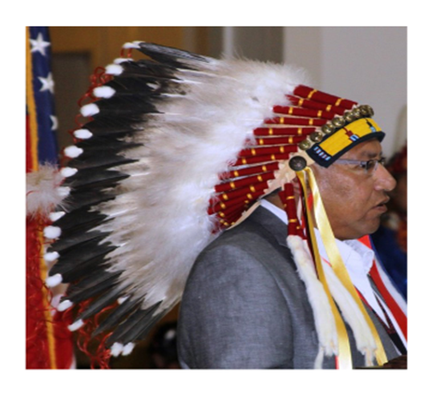
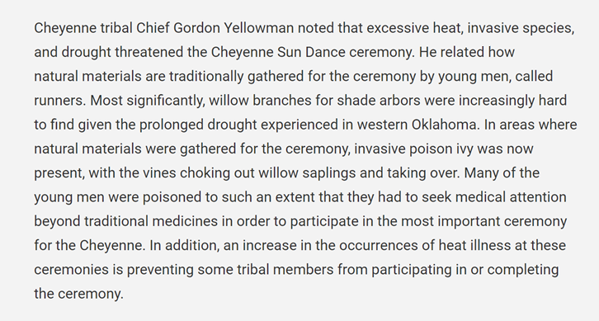
Tribes have Unique Cultural Practices and Resources Threatened by Climate Change
At the 2018 Fourth National Climate Assessment in Chapter 23 on the Southern Great Plains…
https://nca2018.globalchange.gov/chapter/23/

Slide 5
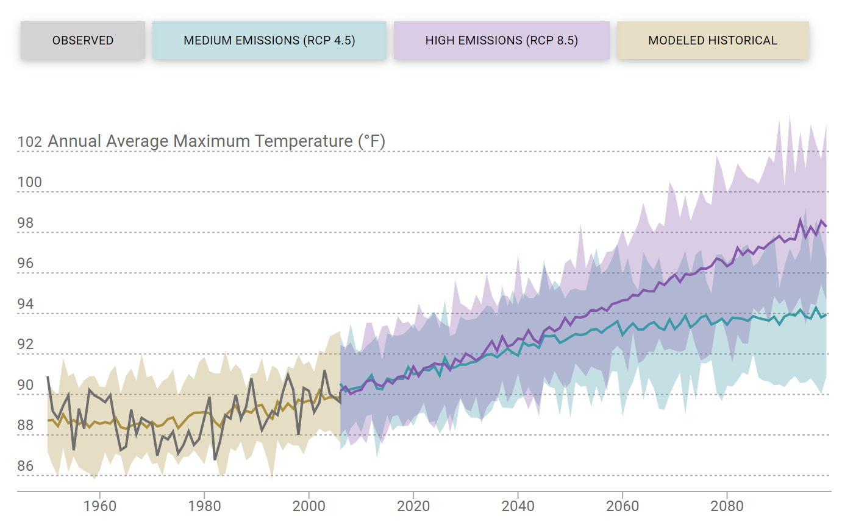
Annual Average Maximum Temperature in Coachella – observed and projected till end of century.
Note: RCP is an acronym for Representative Concentration Pathway and RCP4.5 and RCP8.5 are globally agreed high and low scenarios for the amount of heat reaching the Earth’s surface under varying levels of greenhouse gas emissions
FROM 1961-1990, THE ANNUAL AVERAGE MAXIMUM TEMPERATURE HAS BEEN 88.5F –
THIS COULD INCREASE UNDER A HIGH EMISSIONS SCENARIO AT END-CENTURY BY 8F TO APPROXIMATELY 97F.
From: https://cal-adapt.org/tools/local-climate-change-snapshot/

Slide 6
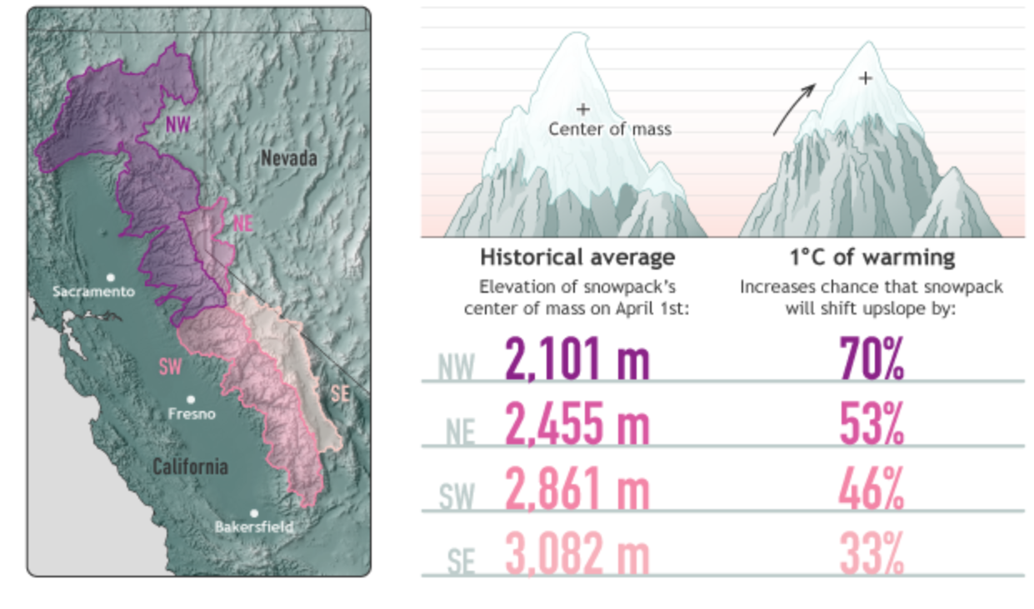
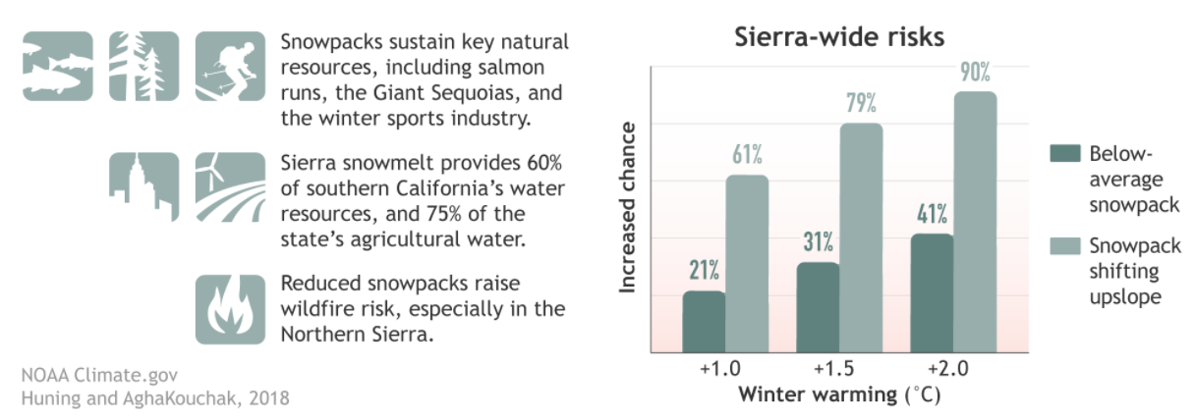
An increase in temperature of 1.8 degrees F/ 1 degree C could significantly reduce the snow pack in the SE Sierras – the snowpack could move upslope by 33%. The reductions would be even more severe in the other Sierra ranges, and up to 70%.

Slide 7
REASONS WHY WE EXPECT INCREASED VARIABILITY AND WEATHER EXTREMES AS THE EARTH WARMS – THAT IS, THE FIRST EFFECTS WILL INCLUDE SEVERE BLIZZARDS AND FLOODS NOT JUST HEAT AND DROUGHT
ICE
Think of a pot of water on your stove, that has ice floating on the top – with gentle heat (upper figure), the water would slowly warm up without much large scale movement of water – the black dot on the bottom would experience increasing temperature. With increasing heat, and more energy into the system (lower figure), hot water could rise up on one side and cold water would sink on the other side in a cycle – from buoyancy and changes in density, much like a hot air balloon. Now, in this case, the black dot would see hot and cold and larger variations in temperature before the temperature simply started to rise and all the cold water on top had heated up.
Greenhouse gases stop the Sun’s energy from escaping the Earth-system after initial entry – essentially increase the energy being input into the system (case on the bottom). The early stages of global warming will be increased variability (hot and cold, wet and dry) of larger magnitudes… eventually we will have only heat and drought!
WE HAVE TO ADAPT
HEAT
INCREASED HEAT
Figures by Gaurav Rajen, TEPA, ABCI

Slide 8
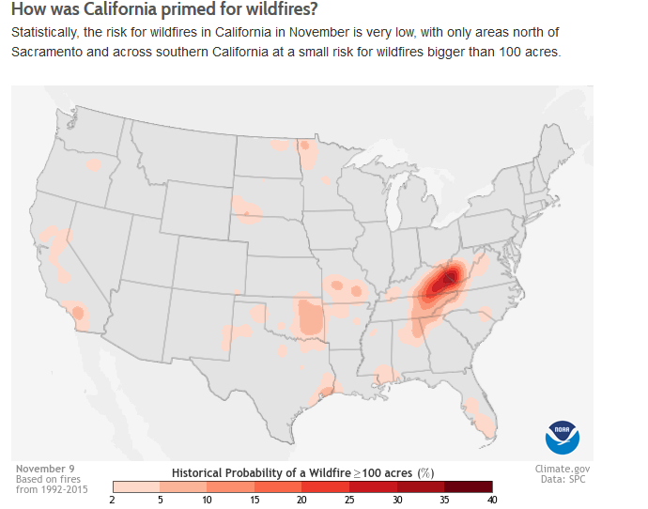

Slide 9
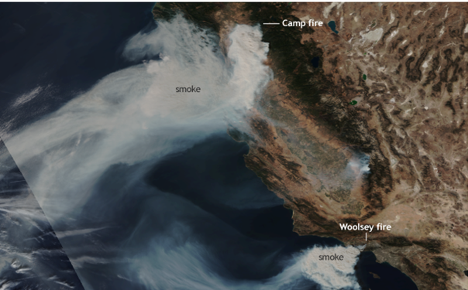
Increasing Wildfires - An Example of Growing Issues of Concern
MASSIVE AND DESTRUCTIVE FIRES IN CALIFORNIA ARE OCCURRING IN WINTER (e.g., NOVEMBER 2018) – HISTORICALLY THE PROBABILITY OF FIRES IN WINTER HAS BEEN NEGLIGIBLE. INCREASING DROUGHT, A RETREATING SNOWPACK, AND A LATE START OF THE WET SEASON ARE CREATING SUCH WINTER FIRES, AND LENGTHENING THE FIRE SEASON.
Fires in California in November 2018

Slide 10
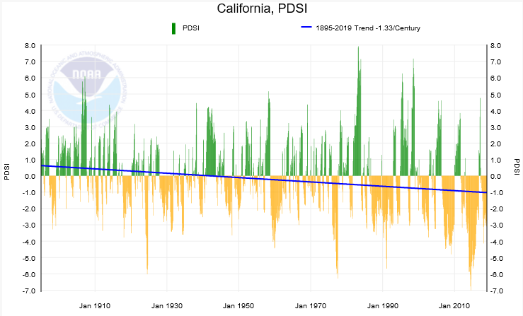
The PDSI is a Drought Index Based on Temperatures, Precipitation and Evaporation – the Trend is for Increasing Drought, Interspersed with Wet Periods

Slide 11
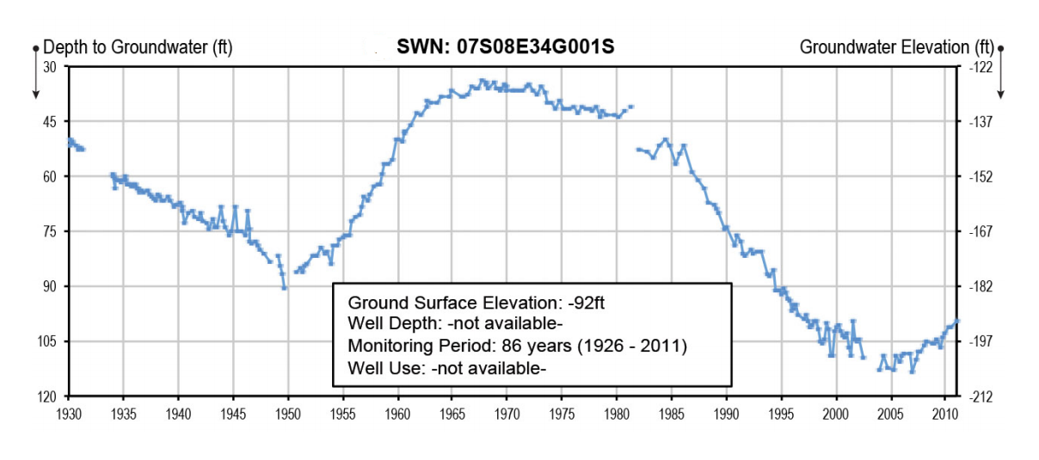
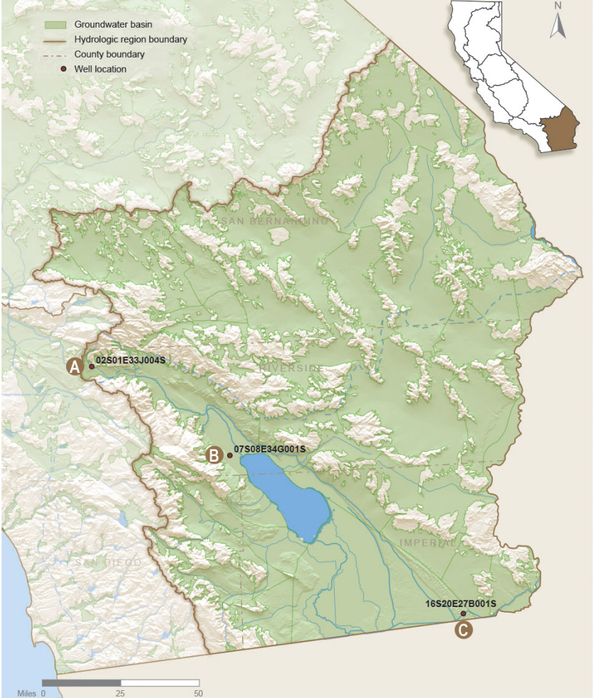
Groundwater Levels in the Coachella Valley – Fluctuations from 1926-2011
The graph shows groundwater levels fluctuating in a shallow well located in the Indio (Whitewater) Groundwater Subbasin. The well is completed in the shallow alluvium and is used for agricultural irrigation. Groundwater levels steadily declined from 1926 to 1949. In 1949, the Coachella Canal started importing water from the Colorado River and levels began to recover from recharge of the aquifers with the Colorado River surface waters. From the early 1970s to 2003, levels dropped again by 75 feet from overuse for agriculture and urbanization. In 2003, levels have started to recover from new arrangements for the Coachella Valley for additional surface waters creating a smaller reliance on groundwater. With Climate Change and increasing temperatures, there will be increased evaporation of the Colorado River waters. Groundwater levels could drop again as allocations of the Colorado River waters will be stressed from competing demands of various entities, including other US States and Mexico. Creating high quality records of groundwater levels on ABCI lands is, therefore, of critical importance.
This well is located northwest of the Salton Sea in the Indio Groundwater Subbasin
https://water.ca.gov/-/media/DWR-Website/Web-Pages/Programs/Groundwater-Management/Data-and-Tools/Files/Statewide-Reports/California-Groundwater-Update-2013/California-Groundwater-Update-2013---Chapter-12-ColoradoRiver.pdf

Slide 12
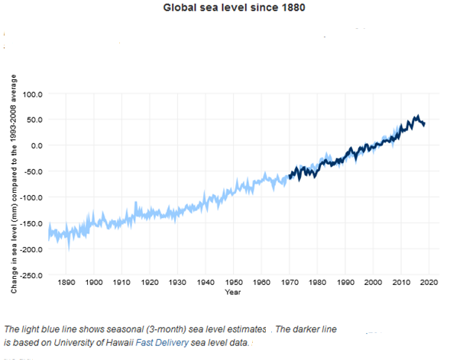
Globally Sea Levels are Rising – the West Coast will Likely See a Rise of 1-2 Feet in the Next Fifty Years (>90% probability); this will Impact the Entire Desert Southwest Including the Coachella Valley
Sea Level Rise will not have a Direct Impact on the ABCI in Terms of Flooding – Increased Storms, Coastal Flooding and Erosion will Cause Species to Migrate and Change Weather Patterns in the Desert Southwest

Slide 13
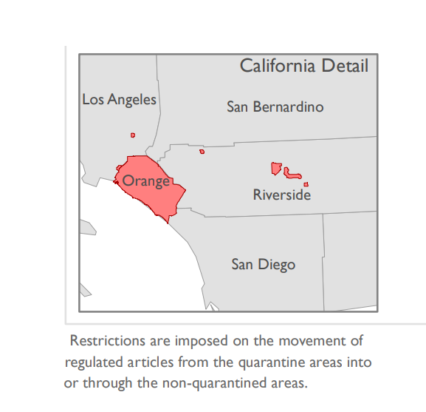
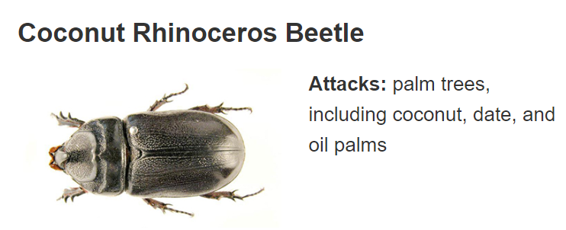
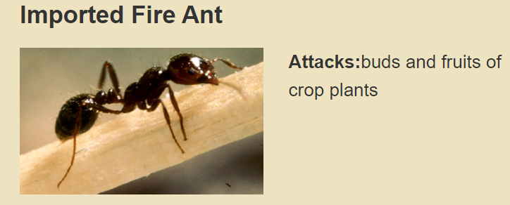
THREATS FROM INVASIVE SPECIES ARE INCREASING AS CLIMATE CHANGE ALTERS HABITATS ALLOWING SPECIES TO MIGRATE INTO NEW REGIONS WHERE PREDATORS MAY NOT EXIST CREATING UNBALANCED POPULATIONS
The USDA’s Animal and Plant Health Inspection Service issues quarantines to try and limit the spread of invasive and destructive species… the map below depicts areas under quarantine in Riverside County for the Imported Fire Ant. Another species of concern is the Coconut Rhinoceros Beetle from SE Asia that is currently in Hawaii and could possibly spread to California.
Quarantines are in effect for the Imported Fire Ant in California
This SE Asian beetle has entered Hawaii and could reach California

Slide 14
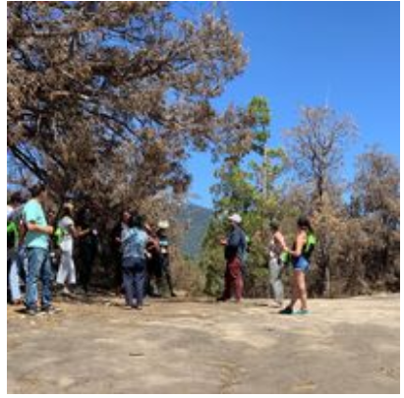
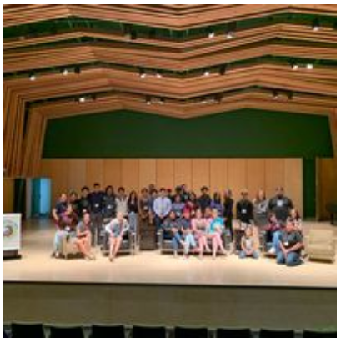
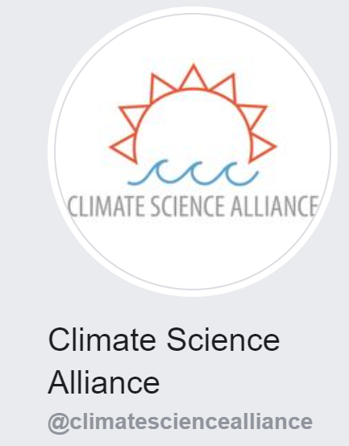
Given the High Likelihood of Major Climate Change Impacts, the ABCI has Joined Data Sharing Networks and Climate Adaptation Planning Groups – e.g. the Climate Science Alliance
Photographs from the 2019 Southwestern Tribal Climate Change Summit
Organized by the Climate Science Alliance

Slide 15
CONCLUSIONS
The ABCI and other tribal nations have unique needs reflected in their relationship to the natural world and ceremonial needs of disappearing plants
Climate effects of major importance to ABCI – next 50 years
Temperature rise (could be as high as 8F by end-century)
Increased fire risks (increased temperatures will reduce the snow pack in the Sierra Nevada mountains, lead to water shortages, and a lengthened fire season
Drought and falling groundwater levels – there will be large extremes in floods and droughts
Sea level increases and indirect impacts (such as invasive species) – a 1-2 feet rise is expected on the West Coast – this will change habitats and the severity of storms causing indirect effects on the desert southwest
Next Steps
Alliances and data sharing networks
A stakeholder-led planning process will revise the existing Climate Change Adaptation Plan of the ABCI
Working Group of stakeholders to assess risks and assets to be protected

